Slide 1
MineCraft Simulation
Group Members: Frank Torchia, Jacob Schreiner, Dustin Chlystek, Samuel Morin, Peter McCloskey

Slide 2
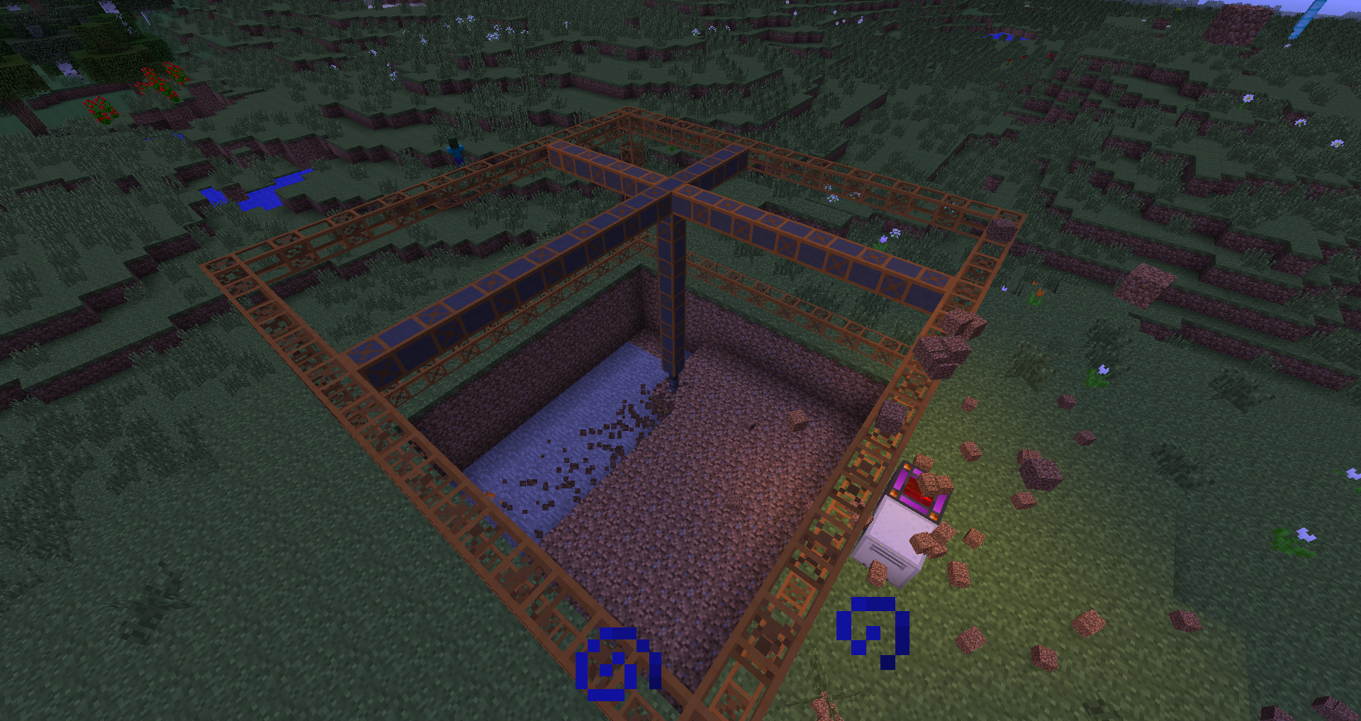
Motivation
The Minecraft mod we focused was centered around the concept of mining with the use of quarries.
Once blocks are mined, there are various thing that can be done with the individual types depending on the paths that are chosen
The motivation behind our simulation was to simulate the mining process and try to find the most efficient uses of power, best bar output, and shortest time in system

Slide 3
Problem Statement
Our core problem that we were investigating was the most efficient way to use blocks mined from quarries we generated
We used the game Minecraft to set up quarries and simulate our various methods of converting and refining the blocks we collected
Minecraft allowed us the environment we needed to set up mining quarries and using a script we wrote, to mine and record the data we needed
With this data we were able to model mining and block generation within our simulation
Once we figured out how to simulate the mining and quarry portion of the simulation we next moved onto optimizing the ways we utilize the blocks

Slide 4
Problem Statement
With our mining done we now moved onto optimizing block usage, this was simulated in three ways, optimal power consumption, bar output, and time
For a background in power consumption, the machines used to shape and form the blocks into ingots and bars use various amounts of power
Power is acquired via mining coal and EU blocks from the quarry
For bar output, we are trying to find the best path to take the blocks or ore, and run them through multiple machines to find which combination of machines produces the most bars regardless of time or power consumption
Finally for time optimization, we are simply aiming to find the shortest amount of time to put all of the blocks through the system and convert them into ores

Slide 5
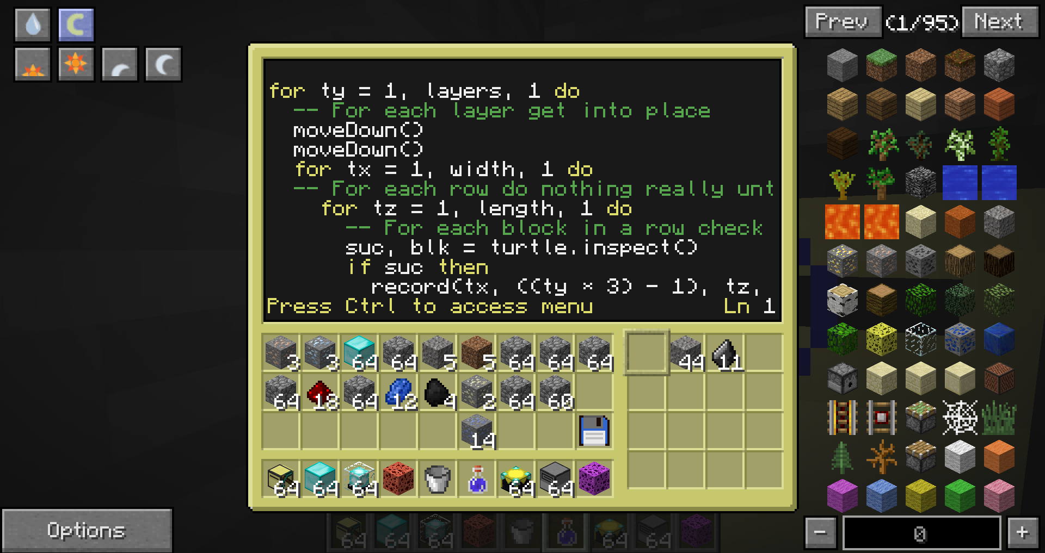
Approach
The initial issue behind beginning our project was acquiring data, as it was not a simulation in a real world we had to collect it from the game itself
After some time spent trying to do it manually, we decided to write a script similar to what a quarry would to give us the data for the simulation

Slide 6
Approach
Once the data was collected and averaged out over multiple quarries we began planning the simulation
After several discussions we decided that our project would be event driven and that the times for the arrival of the blocks would be generated at the beginning of the program
Using a priority queue we were able to sort the block arrival times
As the simulation runs it pulls from the priority queue and executes certain things depending on the event
A path structure we created allows us to set different routes and processes for the ores

Slide 7
Experimental Setup
For our experimental setup we theorized that certain paths would be the best to optimize our multiple goals
Our structure allowed for multiple paths to be taken through various machines which each utilized different amounts of power and took varying amounts of times
Generators receive mined coal and produce the power we will use to work the other machines
Furnaces take ores and dust and convert them into the bars that we are looking for
Varying types of furnaces use varying amounts of power but also can output at more or less speeds than others

Slide 8
Experimental Setup
Machines are used to turn ore into dust
Both ore and dust can be turned into bars, however, these machines allow a chance for the ore to be optimized and output more than just 1 bar
The combination of these varying types of generators, furnaces, and machines are what comprise the varying paths we simulated and tested
Once we finished the simulations of all of the possible paths we were able to ascertain which paths achieved the goals that we were looking for

Slide 9
Results
With the data we’ve gathered thus far, the results don’t show considerable variation in the total amount of bars produced
As the simulations ran we found the most telling data was that of the power consumption along given routes
With the combination of our data so far our conclusion is that the most efficient path in terms of power consumption and bar generation is the path of Machine Set 1, Furnace 2, and Generator 1
We project that the setups will continue to have variable power and that there will eventually be at least 1 or 2 paths that produce significantly more or significantly less bars per run on average

Slide 10
Results

Slide 11
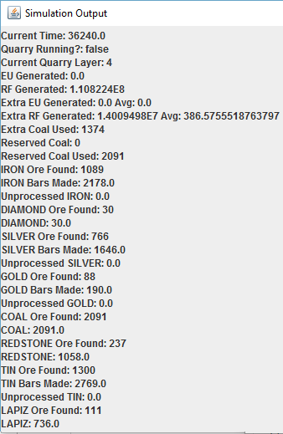
Discussion
Challenges
Getting Started
Data Collection
Simplifications
No Caverns or Clumping
Infinite Coal Supply
If there was more time
Incorporate Clumping and Caverns

Slide 12
Conclusion
The simulation of a mining quarry and refining process proved to be a very complex design to model
Thus far we have found that there isn’t a considerable difference in the amount of bars produced, but that power consumption plays a huge role, we will continue tests until all paths have been exhausted
Future Work
More Realistic Generator Approach
Machine Upgrades
Model Without Environmental Simplifications Such as No Water/Lava

